Slide 1
Sentiment Analysis
Fysekis Thomas

Slide 2
About the Dataset
Amazon Fine Food Reviews
Not API Based for optimal result
More than 500.000 rows
We used 20% of the dataset for our analysis.
Balances computational efficiency with robust analysis.
Faster training and evaluation.
The Importance of Columns
Summary vs Text
We chose Text Over Summary because:
It provides a more detailed and comprehensive context.
It better represents user sentiment and intent.
It is less prone to ambiguity compared to shorter summaries.

Slide 3
Methods and Preprocessing
Preprocessing Steps
Removed noise (e.g., special characters).
Standardized text (e.g., expanded contractions like "can't" → "cannot").
Categorized Sentiments:
Positive: 4–5
Neutral: 3
Negative: 1-2
Model Used
Logistic Regression with TF-IDF vectorization.
Support Vector Machine (SVM) for robust text classification.
LSTM for sequential pattern learning.
CNN (Convolutional Neural Network): Leveraged for feature extraction and text classification.
DistilBERT for state-of-the-art sentiment classification.

Slide 4
Model Training Overview
Matrix
Logistic Regression and SVM
CNN (Convolutional Neural Network):
Used TF-IDF vectorization to transform text into numerical features.
Split dataset into 70% - 30%
Applied filters and pooling layers for efficient feature extraction.
F1
ROC
LSTM (Long Short-Term Memory):
DistilBERT
Implemented word embeddings to represent text numerically.
Fine-tuned a pre-trained transformer model.
3 Epochs
Accuracy

Slide 5
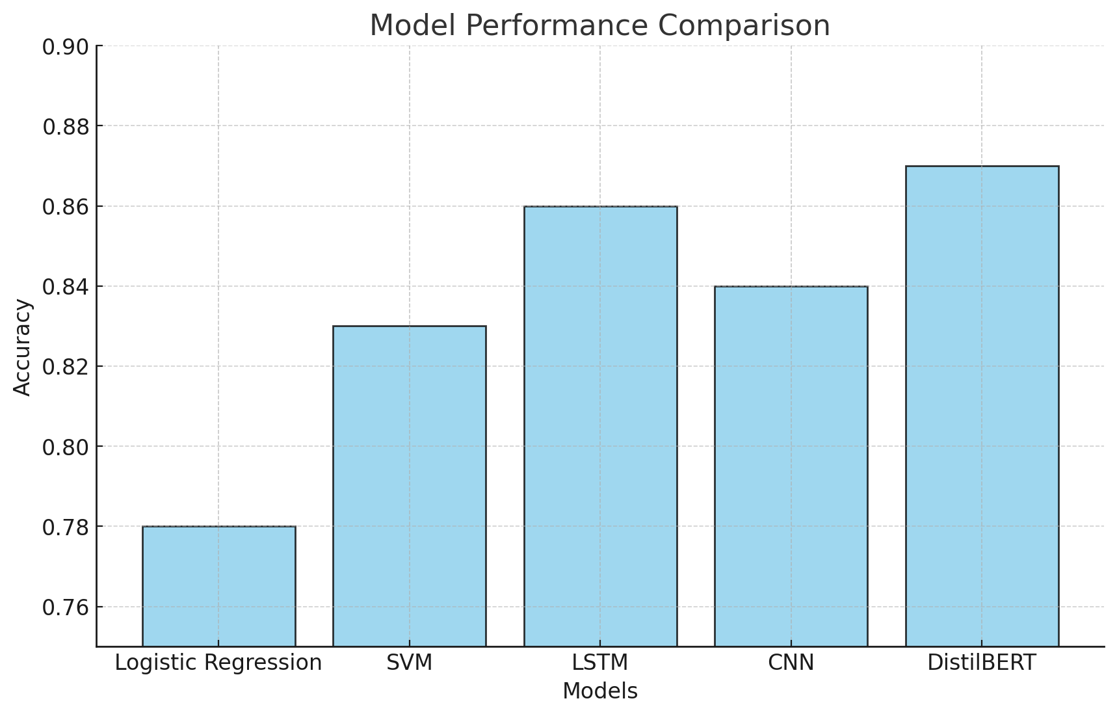
Model Performance Chart:
Key Observations
Best Performance
DistilBERT achieved the highest accuracy (87%) and F1-score but required significant computational resources.
Deep Learning Models:
LSTM captured sequential patterns effectively, achieving 86% accuracy.
CNN performed well at 84%, focusing on feature extraction.
Baseline Models:
SVM (83%) and Logistic Regression (78%) offered quick, interpretable results, suitable for resource-constrained setups.

